Slide 1
When Items was selected in variable, How to delete this variable style

Slide 2
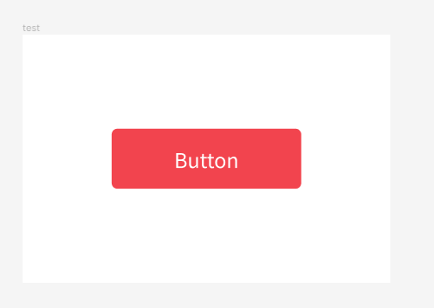
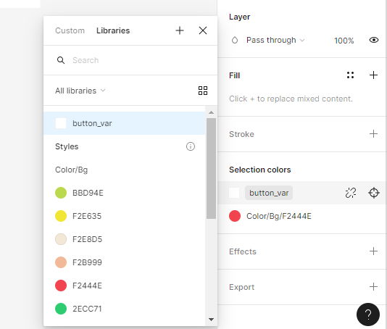
When Items was selected in variable, How to delete this variable style_1

Slide 3
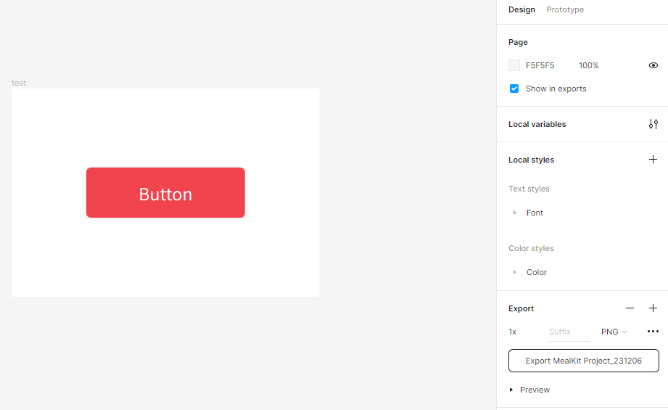
When Items was selected in variable, How to delete this variable style_2

Slide 4
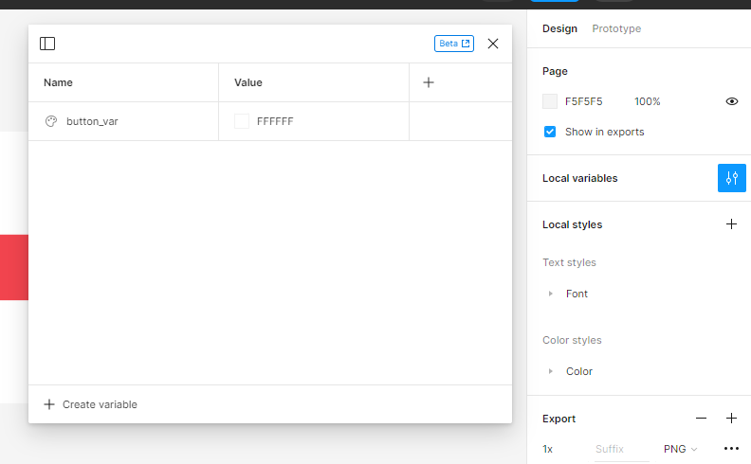
When Items was selected in variable, How to delete this variable style_3

Slide 5
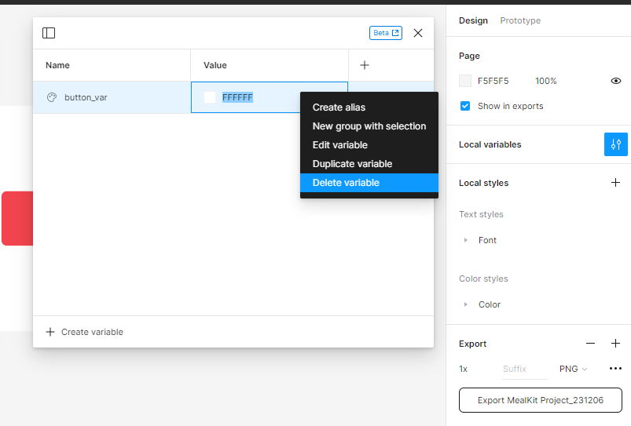
When Items was selected in variable, How to delete this variable style_3

